Slide 1

Filtering in Pandas 1

Slide 2
Filtering Dataframes
New dataframe methods
Nunique()
Duplicated(), drop_duplicates()
New inputs to string methods
Faster way to use apply
Defining functions using lambda
How do I only select row rows that satisfy a certain condition? Multiple conditions?
What is going on under the hood?

Slide 3
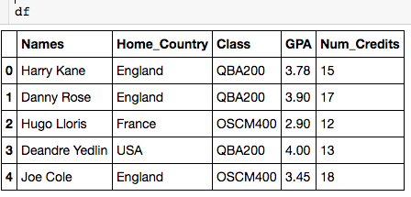

Using nunique()
Can only be applied to single columns

Slide 4
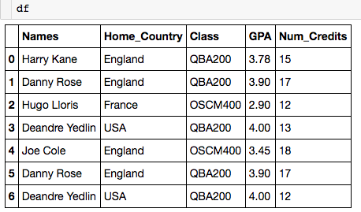
Using duplicated()
Let’s look at how to deal with duplicate columns:

Slide 5
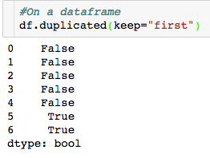
Using duplicated()
Let’s look at how to deal with duplicate columns:
Returns series of boolean with True for all repeated rows.
keep = “first” – put False for the first occurrence.

Slide 6
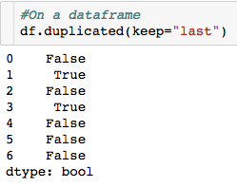
Using duplicated()
Let’s look at how to deal with duplicate columns:
Returns series of boolean with True for all repeated rows.
keep = “last” – put False for the last occurrence

Slide 7
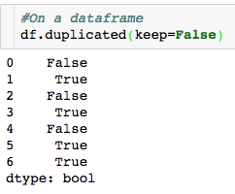
Using duplicated()
Let’s look at how to deal with duplicate columns:
Returns series of boolean with True for all repeated rows.
keep = False – put True for every row of a repeated occurrence

Slide 8
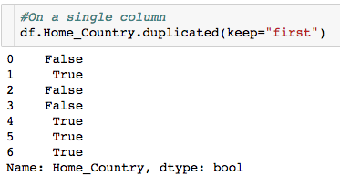
Using duplicated()
Let’s look at how to deal with duplicate columns:

Slide 9
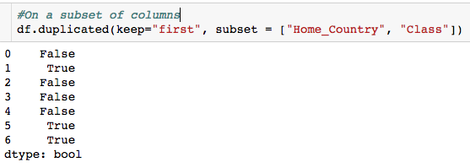
Using duplicated()
Let’s look at how to deal with duplicate columns:

Slide 10
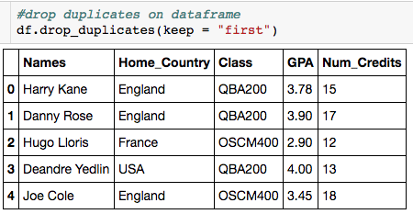
Using drop_duplicates()
Let’s look at how to deal with duplicate columns:
“Drop all duplicate rows except for the first.”

Slide 11
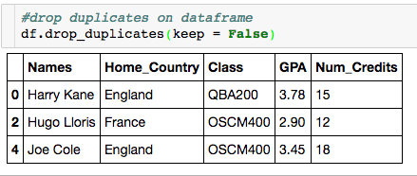
Using drop_duplicates()
Let’s look at how to deal with duplicate columns:
“Drop all duplicate rows.”

Slide 12
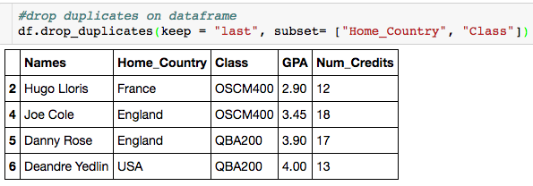
Using drop_duplicates()
Let’s look at how to deal with duplicate columns:
“Drop all duplicate rows based on Home_Country and Class except for the last.”

Slide 13
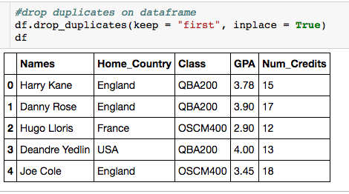
Using drop_duplicates()
Let’s look at how to deal with duplicate columns:
Change dataframe in place

Slide 14
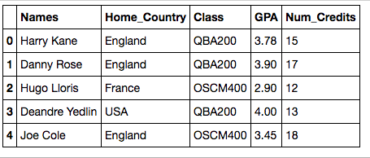
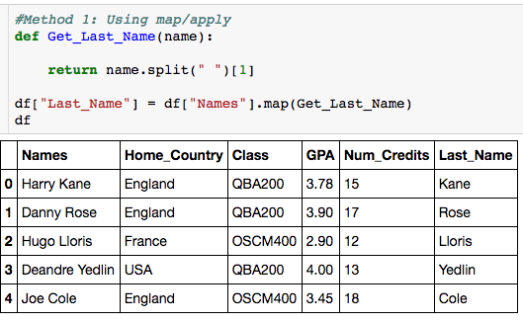
New String Method Techniques
How do I add a column for each person’s last name?

Slide 15
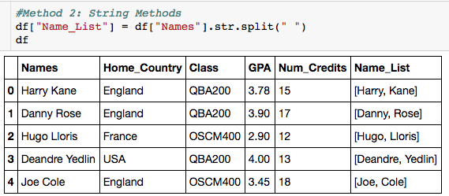
New String Method Techniques
How do I add a column for each person’s last name?
How do I get the last name?

Slide 16
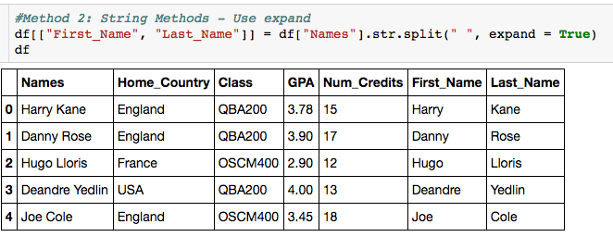
New String Method Techniques
How do I add a column for each person’s last name?
Creates separate column for each element in the list.

Slide 17
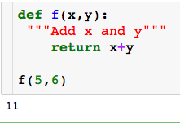
Lambda Functions
Lambda function allows us to create simple function in one line without a def.

Slide 18
Lambda Functions
Lambda function allows us to create simple function in one line without a def.
Let’s see how we can use a lambda function to do the same thing

Slide 19
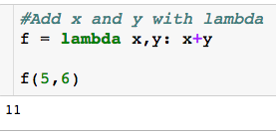
Lambda Functions
Lambda function allows us to create simple function in one line without a def.
Let’s see how we can use a lambda function to do the same thing

Slide 20

Lambda Functions
Dissecting the lambda function:
All lambda function begin by typing lambda

Slide 21
Lambda Functions
Dissecting the lambda function:
All lambda function begin by typing lambda
Function inputs, there can arbitrarily many

Slide 22
Lambda Functions
Dissecting the lambda function:
All lambda function begin by typing lambda
What to return
Function inputs, there can arbitrarily many

Slide 23
Lambda Functions
Dissecting the lambda function:
All lambda function begin by typing lambda
Give function a name so we can use it
What to return
Function inputs, there can arbitrarily many

Slide 24
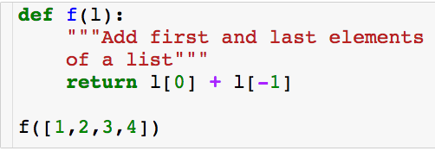
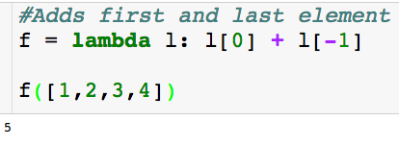
Lambda Functions
Another example:
Lambda function:

Slide 25
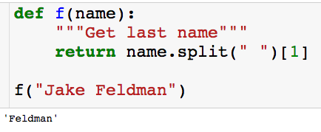
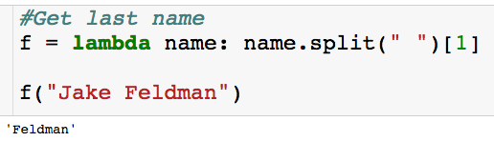
Lambda Functions
Another example:
Lambda function:

Slide 26
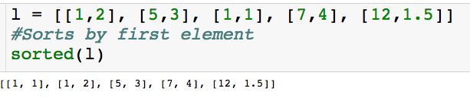
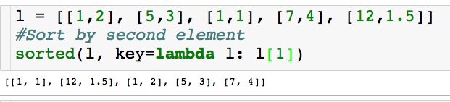
Uses of Lambda Functions
Can uses lamba functions as input to key in sorted function:
Lambda function takes list and returns the second element
With the key parameter you can specify a function to be called on each list element prior to making comparisons. The value of the key parameter should be a function that takes a single argument and returns a key to use for sorting purposes.

Slide 27
Uses of Lambda Functions
Can uses lamba functions as input to key in sorted function:
Lambda function takes list and returns the second element
With the key parameter you can specify a function to be called on each list element prior to making comparisons. The value of the key parameter should be a function that takes a single argument and returns a key to use for sorting purposes.

Slide 28
Use of Lambda Functions
How do I add a column for each person’s last name?
Already wrote this function as a lambda function

Slide 29
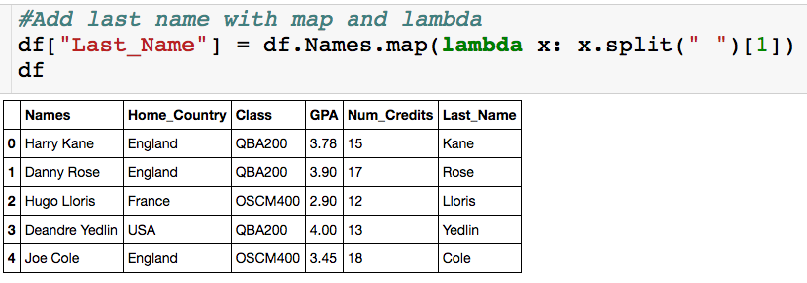
Use of Lambda Functions
How do I add a column for each person’s last name?

Slide 30

Filtering
Always name_df.loc
only rows where GPA>=3
All columns

Slide 31
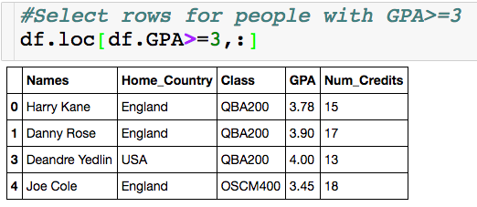
Filtering
Index is messed up
Returns a dataframe

Slide 32
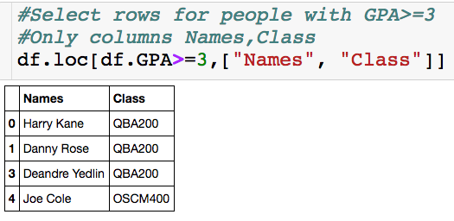
Filtering
We don’t have to select the column we filter on.

Slide 33
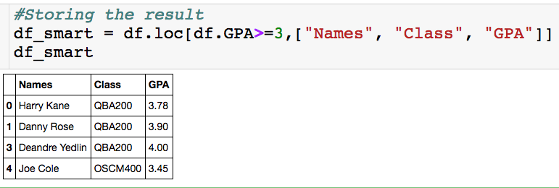
Filtering

Slide 34
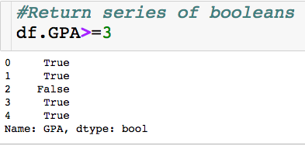
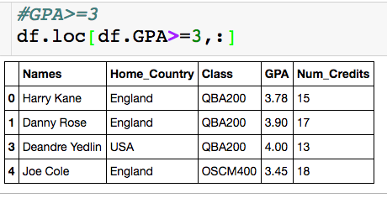
Under Hood
Only keep rows where there is a True

Slide 35

Filtering – Multiple Conditions
“and”
Make sure you put each condition in parentheses

Slide 36
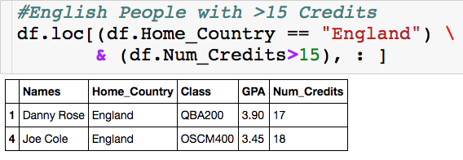
Filtering – Multiple Conditions

Slide 37

Filtering – Multiple Conditions
Returns True if string contains a “D”
“or”

Slide 38
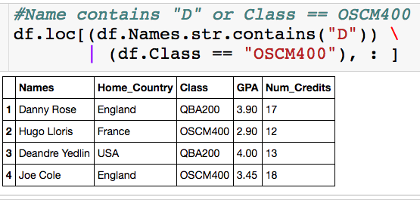
Filtering – Multiple Conditions

Slide 39
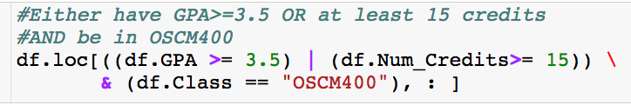
Filtering – Multiple Conditions
What will this give me?

Slide 40
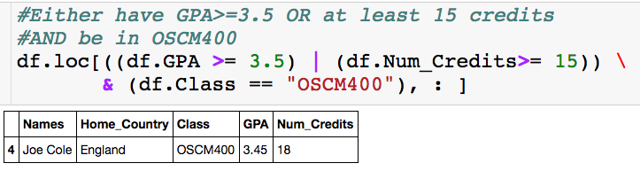
Filtering – Multiple Conditions

Slide 41
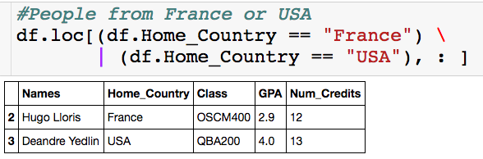
Filtering – Multiple Conditions

Slide 42
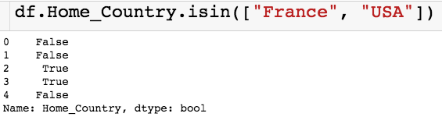
Filtering – Multiple Conditions
Input is a list

Slide 43
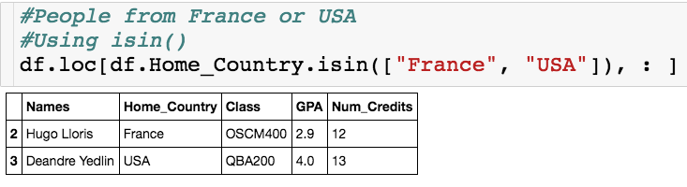
Filtering – Multiple Conditions

